Slide 1
Topic: AI &Prompt Enginnering
Exploring the power of AI and craft of prompt design
Presented by : Himani
Course : AI& Prompt Enginnering
Assignment no.1

Slide 2
Introduction To Ai
What is AI? AI stands for Artificial Intelligence – the capability of machines to imitate intelligent human behavior. It enables computers or systems to perform tasks like understanding language, recognizing images, solving problems, and making decisions. Types of AI: Narrow AI: Performs specific tasks (e.g., Siri, Google Maps). General AI: Hypothetical AI with human-level intelligence. Super intelligent AI: Future concept – surpassing human intelligence. Key Subfields of AI: Machine Learning, Deep Learning, Natural Language Processing (NLP)etc.

Slide 3
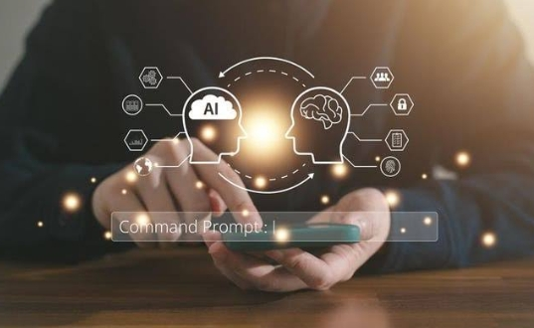
Introduction to Prompt Engineering
What is Prompt Engineering? The process of designing effective prompts (inputs) to guide the behavior of AI language models (like ChatGPT, Bard, Claude). It’s like giving precise instructions to AI so it understands what we want.
Why it Matters: AI models do not “think” like humans. The way we phrase our input changes the output. Prompt Engineering ensures that we communicate clearly with the model.

Slide 4
Importance of AI & Prompt Engineering
Importance of AI:
Automates complex and repetitive tasks. Enables accurate data analysis and decision-making. Enhances efficiency in sectors like healthcare, banking, education, agriculture, and logistics. Powers innovation in speech recognition, image analysis, autonomous systems. Importance of Prompt Engineering:
Ensures high-quality, relevant, and accurate responses from AI. Saves time by reducing trial-and-error while interacting with AI. Essential for tasks like writing, summarizing, translating, coding, tutoring, etc. A rising career skill in data science, UX, AI operations, and education.

Slide 5
Applications of AI
Healthcare: AI diagnoses diseases through medical imaging. Used in robotic surgery, drug discovery, and personalized treatment.
2. Finance: Fraud detection, credit scoring, and algorithmic trading. Chatbots for banking customer support.
3. Education: Personalized learning apps, automatic grading, virtual tutors. Adaptive tests based on student performance. 4. Transport: Autonomous vehicles, traffic optimization, and route planning.
5. Entertainment & Media: Content recommendations (Netflix, YouTube), music creation, and digital art.

Slide 6
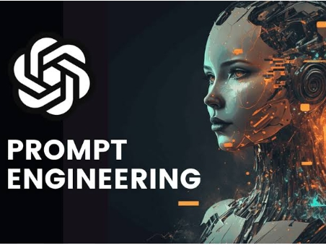
Applications of Prompt Engineering
1.Content Generation: Writing blogs, essays, resumes, social media posts. Rephrasing, summarizing, or translating text effectively. 2. Coding & Debugging: AI can generate code snippets, explain logic, or fix errors when guided with a good prompt. 3. Customer Service: AI Chabot's trained with prompt templates provide 24x7 assistance.
4. Education & Research: Creating quizzes, notes, explanations tailored to grade level or subject. Helping students learn with interactive and simplified answers.
5. Data Analysis: Prompts help extract key points, patterns, or summaries from large data.

Slide 7
Key Concepts in AI & Prompt Engineering
AI Concepts: Machine Learning (ML): Algorithms learn from data (e.g., spam filters). Neural Networks: Layers of nodes that mimic human brain patterns. Natural Language Processing (NLP): Allows AI to understand and respond in human language. Deep Learning: Advanced ML using complex neural networks. Prompt Engineering Concepts: Zero-shot Prompting: No examples given to AI. Few-shot Prompting: A few examples are provided in the prompt. Chain-of-thought Prompting: AI is asked to explain step-by-step reasoning. Role Prompting: Assigning AI a role (e.g., “Act like a career counsellor.”) Formatting Tips: Be specific, structured, and clear.

Slide 8
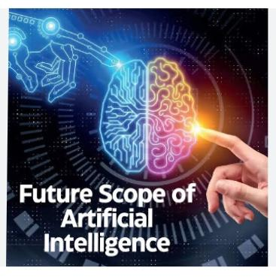
Future Scope
AI’s Future: Integration in every industry: smart homes, agriculture, defense, space, etc. AI will become more ethical, transparent, and autonomous. New jobs in AI ethics, AI operations, data labeling, etc.
Prompt Engineering’s Future: Emerging as a must-have skill in AI interaction and product design. Will be taught alongside coding and digital communication. Essential for training AI to be inclusive, safe, and unbiased.

Slide 9

Thanks for watching my Presentation

